Slide 1
2023 Core Service Review
Public Information Session
September 20th, 2023

Slide 2
Tonight’s Agenda
Filling You In Re. Brock’s Core Services Review
Brock’s Current Situation
Council’s Performance Brand
Wildly Important Goals for Brock (WIGs)
Doing the Right Things: Shedding Lower Value-Added Services/Activities
Next Steps

Slide 3
Performance Concepts Team
Municipal management consulting team…HQ in Uxbridge
250+ municipal performance improvement assignments since 2001
Performance Concepts Team:
Todd MacDonald
Michelle Casavecchia-Somers

Slide 4
Core Service Review What Is It?

Slide 5
Core Services Review – 2 Aligned Elements

Slide 6
2023 Core Service Review
Recognizes that Brock’s portfolio of services (and their component parts) needs to be critically reviewed
CSR will guide Council re. the go-forward mix of existing and potential new assets/services
Critical tool for staff to execute/support Council’s strategic priorities (Wildly Important Goals)

Slide 7
Key Performance Indicators (KPIs) & Results Targets

Slide 8
Key Performance Indicators: Accountability for Real World Results
Taxpayers Connect
the Dots Between
Tax Burden and
Results Provided
Results
Dashboard
KPIs + Targets

Slide 9
Brock’s Current Situation

Slide 10
Strengths to Build On
Re-configured Brock organizational structure; Form Follows Function
Revitalized/stabilized CAO and leadership team with clear mandates
Council willingness to take action to modernize operations and control service delivery costs
Brock’s moderately strong financial balance sheet and accumulated reserves and reserve funds
Durham Region’s forecast of slow but steady population and employment growth in Brock.

Slide 11
Unfinished Business in Creating Mature Brock
When Brock was created through amalgamation in 1974, many of its operations were integrated & a unified staffing model created
But consolidation did not occur for a range of municipal facilities (i.e. arenas), as they were in good condition and had significant life still remaining
Today many of these facilities need significant rehabilitation/ re-investment…looming $ price tag

Slide 12
Brock Amalgamation Realities
Brock Township
Staff
O Reg 588/17 is a gamechanger
Large $ re-investment in “Triplet”
Arenas/Fire Halls + 2 Libraries
are looming, but not yet factored into
multi-year capital planning
Assets
+
Facilities
Facility “Triplets”
depreciated/consumed
over decades
Road network systemically underfunded
for sustainable life-cycle replacement
NOW
1974

Slide 13
Asset Consumption – 3 Arenas
1948
2011
All 3 Arenas are operating beyond their standard asset lifecycles!

Slide 14
$ Risk Exposure Facing Brock

Slide 15
Reg 588/17 = Total Gamechanger
PROVINCIAL DEADLINE: JULY 2024
PROVINCIAL DEADLINE: JULY 2025
Province is determined to compel municipal sector compliance via a mix of carrot and stick tactics

Slide 16
Asset Management Day of Reckoning
Brock’s Asset Management Day of Reckoning is close (O Reg 588/17 deadline is mid-2025)
Brock is at an unavoidable cross-roads:
Continue historic pattern of operating “triplet” core facilities
Where is $25 Million coming from for this model to continue?
OR……
Finish the 1974 amalgamation by finally integrating facilities & reducing impending/unavoidable unfunded $ liability

Slide 17
North Durham Peers Generate Service Level Pressure
Performance Concepts took a comparative look at the other North Durham municipalities – Scugog and Uxbridge

Slide 18
Brock / Scugog / Uxbridge
FACILITIES & ASSETS PORTFOLIO
FACILITY | UXBRIDGE | SCUGOG | BROCK
Libraries | 1 | 1 | 3
Fire Stations | 1 | 2 | 3
Arenas | 1 | 2 | 3
INFRASTUCTURE | UXBRIDGE | SCUGOG | BROCK
Paved lane km | 530 | 450 | 269
Percentage Good/V. Good | 48% | 65% | 62%
Paved lane km / 100 supporting households (taxpaying units) | 6.5 | 5.0 | 5.1
Bridges/Culverts (sq m) | 3,174 | 2,174 | 6,410

Slide 19
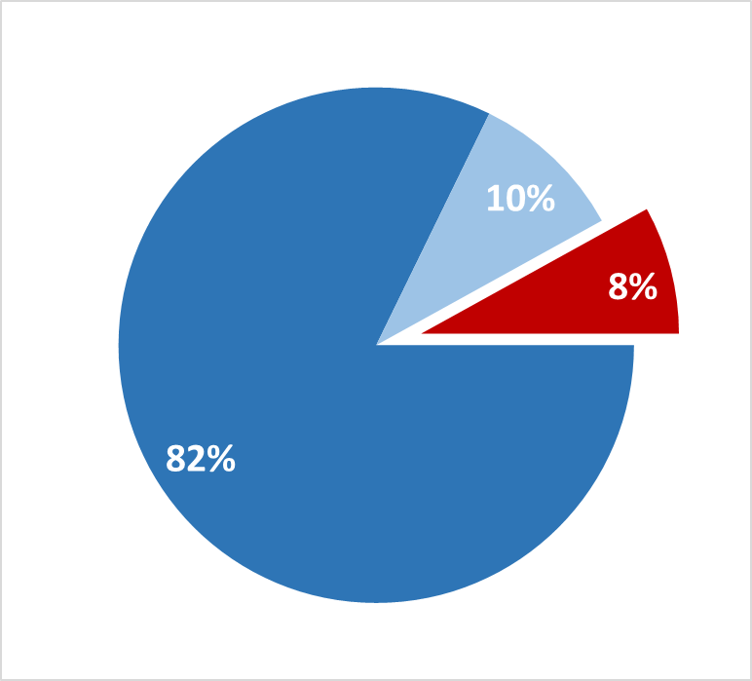
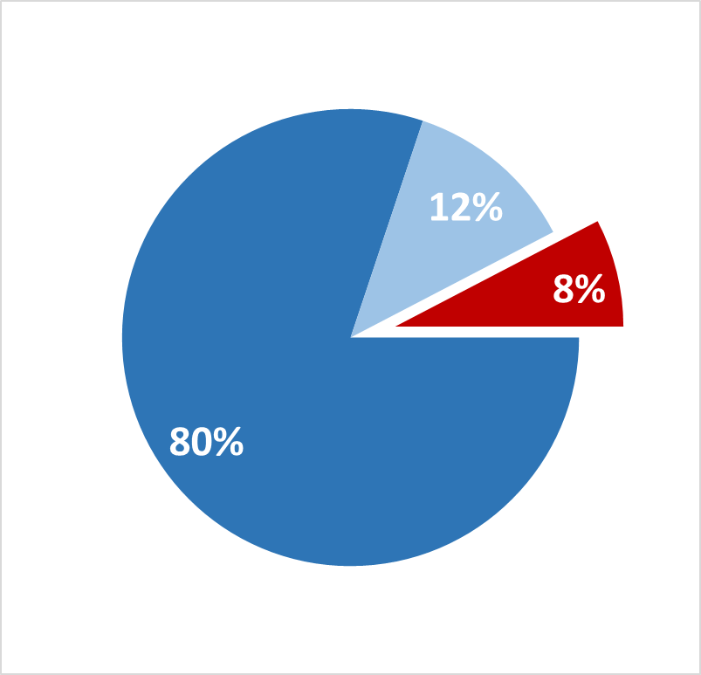
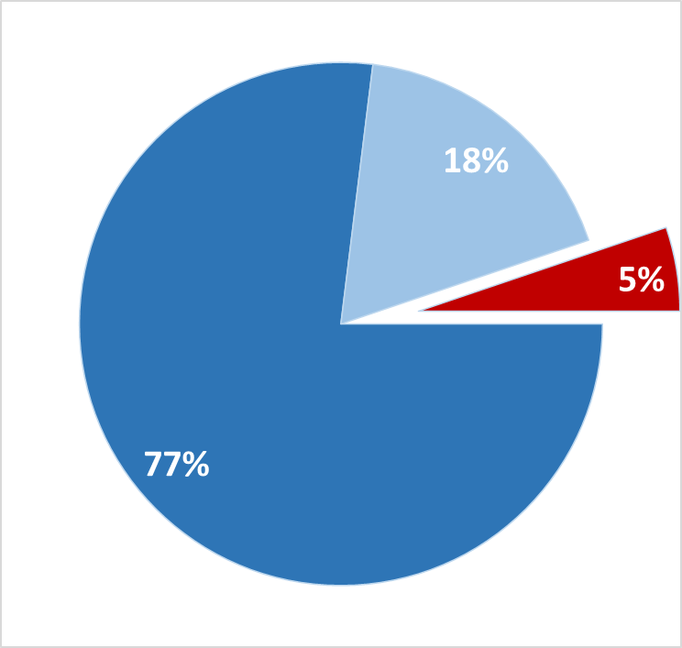
Taxable Assessment Shares
Farm
Farm
Residential
Farm
Residential
Residential
UXBRIDGE
SCUGOG
BROCK
Residential Tax Rates
0.29%
0.33%
0.46%
UXBRIDGE
SCUGOG
BROCK
Red Piece = Commercial/Industrial with higher effective tax rates

Slide 20
Brock Council’s Performance Brand

Slide 21
At the end of this term of Council… As you turn and look backwards over your 4 years working together, what Results Brand will best describe your collective achievements?
A Question for Brock Council

Slide 22
A Financially Responsible/Modernizer Council
Focused on actions to become ‘One Brock’ re. a sustainable asset/facilities model
Addressing Brock’s asset management unfunded liability
Ensuring existing assets/facilities/services are properly funded and maintained before adding new ones
Divesting assets that no longer provide good value for money
Focused on investing in modern technology tools to provide more efficient service delivery
Measuring service results and setting targets linked to budget cycle and outcomes
Implementing policies and programs to modernize operations and ensure continuous improvement
Partnering with other municipalities or community groups to share costs of service delivery

Slide 23
Council’s Wildly Important Goals (WIGs)

Slide 24
Identifying Wildly Important Goals (WIGs)
Council should consider the categories identified in the Situation Analysis when establishing WIGs:
Moving to “One Brock”
Asset Rationalization
Addressing Fiscal Realities
Modernized Service Delivery

Slide 25
WIG #1 - “One Brock” AMP
Complete a Core Services Asset Management Plan that embraces a “One Brock” approach to facilities rehab/ reconstruction & divestiture
Conduct a condition assessment of all buildings/ facilities to establish priority and plan for rehab/ reconstruction projects.
Council approval by mid-2024

Slide 26
WIG #2 - Multi-Year Roads Sustainability Plan
Create a Roads Sustainability multi-year business plan that incorporates targeted levels of proactive surface maintenance hours/$ as well as required capital upgrades to maintain or improve Pavement Quality scores
Create business plan in 2024 & begin implementation in 2025 budget cycle
Monitor Pavement Quality and report on reduction in capital unfunded liability by end of 2025

Slide 27
WIG #3 - “State of the Infrastructure” Annual Report
Deliver “State of the Infrastructure” annual reports to Council in order to track progress in reducing unfunded liabilities identified in the Asset Management Plan and maintain momentum around identified asset/facility divestiture commitments
Deliver initial “State of the Infrastructure Report in Q1 2025

Slide 28
WIG #4 - Fire Station Location Review
Execute a Fire Station Location Review to evaluate the feasibility of modifying the existing 3-station model in Brock.
Execute Station Location Review in Q1-2 2024 in order to inform Core Services Asset Management Plan due in mid-2024

Slide 29
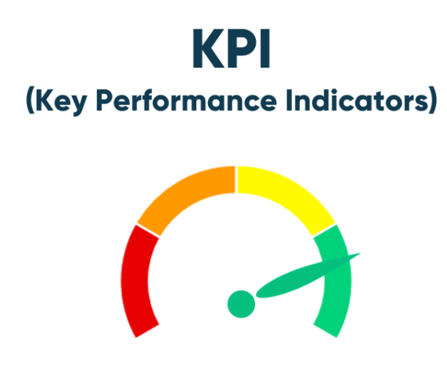
WIG #5 - Annual Budget to be Informed by Results Targets and Reporting
Transform Brocks annual budget cycle by introducing service delivery RESULTS TARGETS and Key Performance Indicator (KPI) RESULTS REPORTING
Pilot Implementation in 2024 budget cycle followed by full Implementation for all Brock core services in 2025

Slide 30
WIG #6 - Implement Work Order Technology Solution
Implement a state-of-the-art Work Order/Maintenance Management technology solution in order to deliver planned maintenance programs across Brock’s network of roads, bridges, culverts, parks, sports fields, arenas, and cemeteries
Secure & configure the technology solution in 2024 and “go live” January 1st 2025

Slide 31
WIG #7 - Initiate Formal Shared Services Program
Initiate a formal/on-going Shared Services program with North Durham (or other) municipal partners
Create a service sharing program “framework” for evaluating service sharing proposals by mid-2024
Select/begin implementing a pilot service sharing deal before the end of 2024

Slide 32
Setting Wildly Important Goals: The Law of Diminishing Returns
Number of Goals
(+ Whirlwind)
2-3
4-10
11-20
Goals Achieved with Excellence
2-3
1-2
0
The fundamental principle at work is that human beings are genetically hardwired to do one thing at a time with excellence.

Slide 33
Achieving Strategic Priorities via Relentless Focus
For strategic success, Council must focus simultaneously on a small number (2-3) Wildly Important Goals (aligned with its Results Brand) at any given point in time.
The WIGs have been organized into clusters that allow for a phased execution.
“Do Now…Do Next”

Slide 34
WIG Cluster #1
The recommended “Do Now” 1st WIG cluster requires action immediately and over the next year to:
i) Meet pending legislative requirements
ii) Achieve a sustainable asset/facilities model
iii) Begin to modernize operations to achieve efficiencies

Slide 35
Cluster #1 - Do Now WIGs
WIG #1 - ‘One Brock’ AMP
WIG #2 - Multi-Year Roads Sustainability Plan
WIG #6 - Implement Work Order Technology Solution

Slide 36
Cluster #2 - Do Next WIGs
WIG #3 - “State of the Infrastructure” Annual Report
WIG #5 - Annual Budget to Be Informed by Results Targets and Reporting

Slide 37
Cluster #3 - Do Next WIGs
WIG #4 - Fire Station Location Review
WIG #7 - Initiate Formal Shared Services Program

Slide 38
Restructuring of Low Value-Added Services/Assets

Slide 39
CSR Triage Tool
The Performance Concepts Team have developed a CSR “Triage Tool” to evaluate Brock’s existing and new services/assets
Purpose is to determine whether some services/ assets are suitable for possible restructuring/service sharing opportunities

Slide 40
Triage Tool addresses 1st question by posing a series of evaluation criteria/tests that provide clarity:
Should we keep/divest/acquire this asset?
Should we be delivering this Service or Service Component?

Slide 42
NEXT STEPS
Core Services Review

Slide 43
Core Service Review - Next Steps…
Receive Public feedback on CSR process and emerging issues (September 20th to 26th)
Performance Concepts Team will use public input to inform our final CSR Report
Presentation of our final CSR Report to Brock Council (October 10th)

Slide 44
Let Us Know…
Access Mentimeter.com interactive polling tool at:
www.menti.com
Code: 8309 0804

Slide 45
Let’s Talk…

